Slide 1

SOFTWARE TESTING
By Satya

Slide 2
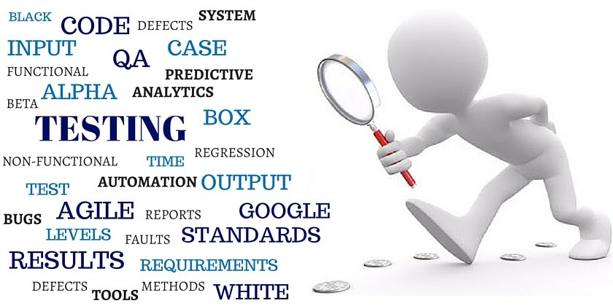
Introduction of softwARE TESTING
Software testing can determine the correctness of the software. It is the way to assess the quality of the software and reduce the risk of software failure in any operation by finding the errors.

Slide 3
DEFINITION OF Software testing
Software testing is the process of evaluating the software to identifying any errors, gaps or missing requirement versus the actual requirement.
It helps the software with bug free.
It is mainly used to test the code without any errors.

Slide 4
Need of software testing
Security.
Quality of the Product.
Determining the performance of the software.
Enhancing the development process.
Verification and Validation.
To find the errors in the software.
Verify all the aspects of the software.

Slide 5
error failure defect
Error: A mistake in the coding is called “Error”
Defect: An Error found by tester is called “Defect”
Failure: The code does not meet the requirements then it is called “Failure”

Slide 6
Causes of software defects
Defects in the code.
Insufficient Testing.
Incorrect Design.
Availability of poor tools.
Lack of Software Skills.
Communication problems.
Third party tools also containing bugs.
Last minute changes.

Slide 7
Cost of software defects
The cost of Software Defects can be measured by the impact of the defects and when we find them. When the defect or error is found in the design can be corrected and it can be re-issued. But if the error is not caught in the specifications and it is not found till the user acceptance then the cost to fix those errors or defects will be too expensive.
If the error is made and the consequent defect is detected in the requirements phase then it is relatively cheap to fix it.

Slide 8
Software testing reveal
Software testing reveal is known as the review of the software and development of the software products and comparing the differences.

Slide 9
Importance of software testing
Determine the quality of the software.
Used to BUG-Free code.
Determine Software Performance.
Avoid Additional Expenses.
Security.
Satisfaction of the customer.
Identifying the errors in the code.

Slide 10
Importance of testing early in Sdlc phases
SDLC stands for Software Development Lifecycle and it is the process of developing information system with proper analysis, design, implementation and maintenance.
Improvement in product quality.
Verification and Validation.
Identifying bugs and defects.
Economic Importance.

Slide 11
Testing and Quality
Testing is the process or activity that checks the functionality and correctness of the software according to specified requirements in order to improve the quality of the software.
The process of identifying the Bugs in the software is known as “TESTING”.
Quality is the review of system or software products and its documentation for that system meets the requirements and specifications.
It is about the activities designed to make sure the software conforming to the end users.

Slide 12
Quality perception
Quality perception is the quality of a product or software according to the customer’s perception.
The more number of defects found, would be quality of development will be poor.
Code quality.
Reliability.
Performance.
Correctness.
Usability.

Slide 13
Testing principles
There 7 testing principles are in Software Testing:
Testing shows the performance of defects.
Exhausting testing is immpossible.
Early Testing.
Defect Clustering.
Pesticide Paradox.
Testing is context dependent.
Absence of errors fallacy.

Slide 14
Economics of Testing
There is a definite economic impact of software testing:
One is cost of defects.
The way we perform testing.

